Slide 1

Computer Architecture
Keivan Navi
Cal Poly Pomona University
knavi@cpp.edu
Office hours: Tu/Th 5:25 Pm to 6:55 Pm
Office: 8-49

Slide 2
Computer Architecture
From Flip-Flop to Flip-Flop

Slide 3
From Flip-Flop to Flip-flop
To "change a flip flop to the other flip flop" means to convert one type of flip flop (like an SR flip flop) into a different type of flip flop (like a JK flip flop) by modifying its input logic, essentially creating a new circuit with the desired functionality using additional logic gates to achieve the desired behavior of the new flip flop type; this often involves creating a conversion table and using logic simplification techniques like K-maps to determine the required input connections for the new flip flop based on the original flip flop's output and state.

Slide 4
From FF to FF (continued)
Conversion tables:
To convert between flip flop types, you need to create a conversion table that maps the input combinations of the original flip flop to the required input combinations of the new flip flop, considering the current state of the flip flop
Logic gates:
By adding or modifying the connections of logic gates within the circuit, you can achieve the desired input behavior for the new flip flop type.

Slide 5
Steps To Convert from One Flip Flop to Other
Steps To Convert from One Flip Flop to Other
Draw the truth table of the required flip-flop.
Write the corresponding outputs of sub-flip-flop to be used from the excitation table.
Draw K-Maps using required flip flop inputs and obtain excitation functions for sub-flip-flop inputs.

Slide 6
Conversion of J-K Flip-Flop into D Flip-Flop
Step-1: We construct the characteristic table of D flip-flop and excitation table of JK flip-flop.
Step-2: Using the K-map we find the boolean expression of J and K in terms of D.
Step-3: We construct the circuit diagram of the conversion of JK flip-flop into D flip-flop.

Slide 7
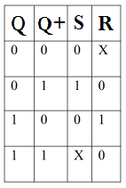
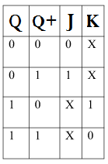
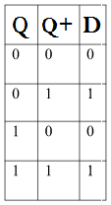
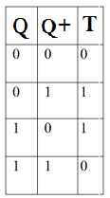
Excitation Table of different Flip-Flops
SR: JK:
D: T:

Slide 8
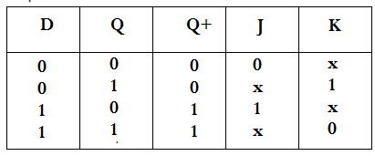
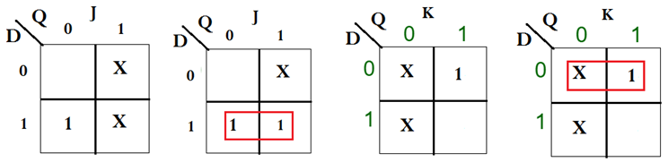
D Flip-Flop from JK Flip-Flop
How can we define J and K:
J: D K: D’

Slide 9
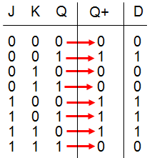
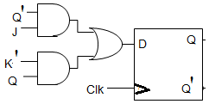
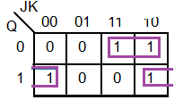
Converting a D Flip-Flop to JK Flip-Flop
The corresponding table as well as the k-map and the related schema follows:

Slide 10
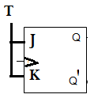
Converting a JK Flip-Flop to T Flip-Flop
In order to convert JK FF to T FF it is enough to connect J and K:
Solve it to confirm that it is correct.
Use the general algorithm of conversion.

Slide 11
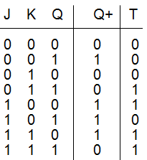
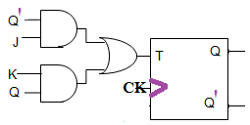
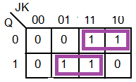
Converting a T Flip-Flop to JK Flip-Flop
The corresponding table as well as the k-map and the related schema follows:

Slide 12
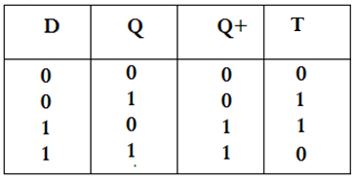
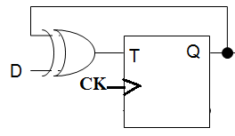
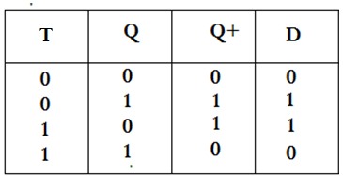
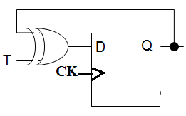
Converting D Flip-Flop to T Flip-Flop Converting T Flip-Flop to D Flip-Flop
T= D XOR Q
D= T XOR Q

